Slide 1
Tissue Box Designer
By Ethan Samangy, Safal Shrestha, Aryan Tamrakar

Slide 2
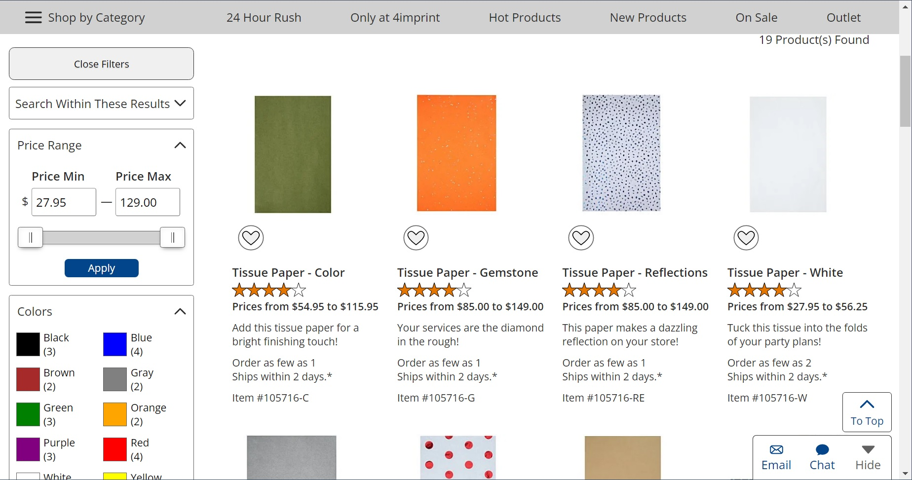
A Model to Learn From:
Papermart
This competitor site gives a simplistic UI with easy-to-understand options for the user. However, it is dull and unattractive and does not allow customization.

Slide 3
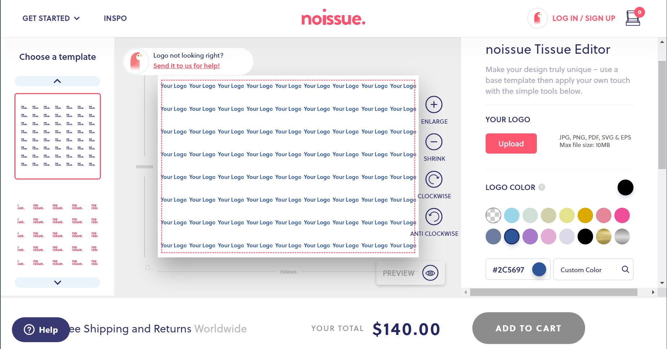
A Model to Follow:
Noissue
The best way to learn is from an example and this site is a great example. They have a great UI with simple, easy to understand options.

Slide 4
Participant 1
Our Questions:
Their Answers:
1) What is the most irritating thing in other commercial sites you have encountered?
2) Do you prefer a minimalistic website or a flashy website?
3) Do you prefer still photos on a site or more live photos on a site?
1) When everything is stuffed together and it's not clean. Moreover, when the description of the product is not good.
2) Minimalistic.
3) Still photos, from different angles.

Slide 5
Participant 2
Our Questions:
Their Answers:
1) How much control do you like when customizing the product you buy?
2) Do you want to see the ratings on a product?
3) Do you prefer still photos on a site or more live photos on a site?
1) 7-8/10.
2) Yes. Is it safe for the environment?
3) Live photos.

Slide 6
Participant 3
Our Questions:
Their Answers:
1) Would you like to log in to a site you are buying from or just continue as a guest?
2) Do you prefer a minimalistic website or a flashy website?
3) When buying tissue papers, how many boxes do you buy at one time?
1) Continue as a guest.
2) Minimalistic.
3) 2.

Slide 7
Think
Says
Saves time and is easier
Likes Reviews
Customizing products like I like it to give me more freedom of what I would like to buy
Thinks they can inspect the product they are going to buy in a more proper way
Likes to continue as a guest
Likes live photos
Likes customizing the product they are going to buy
Feel
Do
In control and satisfied
Customizes the tissue box
Informed and in control
More productive as time was saved and not felt bored
Safe as he knows what he is buying and spending his money
Continues as a guest
reads the reviews

Slide 8
Need
Insight
The UI needs to be simplistic yet versatile.
A clean user-friendly UI is important for attracting new users

Slide 9
Need
Insight
Creating a site that allows one to design and purchase without creating an account
Accounts allow users to save data and other miscellaneous things. However, for the average user who uses the site a few times an account is unnecessary.

Slide 10
Summary
People need a simple yet strong UI when using a designer where all options have clear descriptions.
Having premade designs will help introduce users to the design process.
Having a help box or info box will help the user if they get stuck at any point during the design process.

